Slide 1

4.2 Adaboost and Object Detection
《机器学习》课件

Slide 2
Principle of Adaboost
Three cobblers with their wits combined equal Zhuge Liang the master mind.
Failure is the mother of success
Strong
classifier
Weak classifier
Weight
Features
vector

Slide 3
Toy Example – taken from Antonio Torralba @MIT
Each data point has
a class label:
+1 ( )
y_{t} =
-1 ( )
and a weight:
w_{t} =1
Weak learners from the family of lines
h => p(error) = 0.5 it is at chance

Slide 4
Toy example
Each data point has
a class label:
+1 ( )
y_{t} =
-1 ( )
and a weight:
w_{t} =1
This one seems to be the best
This is a ‘weak classifier’: It performs slightly better than chance.

Slide 5
Toy example
Each data point has
a class label:
+1 ( )
y_{t} =
-1 ( )
We update the weights:
w_{t} w_{t} exp{-y_{t} H_{t}}
We set a new problem for which the previous weak classifier performs at chance again

Slide 6
Toy example
Each data point has
a class label:
+1 ( )
y_{t} =
-1 ( )
We update the weights:
w_{t} w_{t} exp{-y_{t} H_{t}}
We set a new problem for which the previous weak classifier performs at chance again

Slide 7
Toy example
Each data point has
a class label:
+1 ( )
y_{t} =
-1 ( )
We update the weights:
w_{t} w_{t} exp{-y_{t} H_{t}}
We set a new problem for which the previous weak classifier performs at chance again

Slide 8
Toy example
Each data point has
a class label:
+1 ( )
y_{t} =
-1 ( )
We update the weights:
w_{t} w_{t} exp{-y_{t} H_{t}}
We set a new problem for which the previous weak classifier performs at chance again

Slide 9
Toy example
f₁
f₂
f₄
f₃
The strong (non- linear) classifier is built as the combination of all the weak (linear) classifiers.

Slide 10
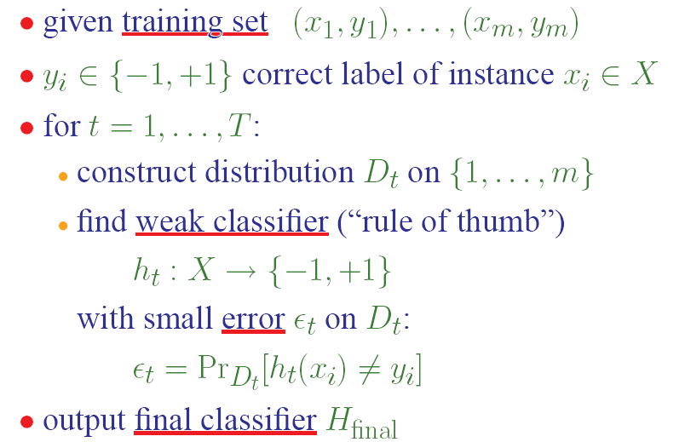
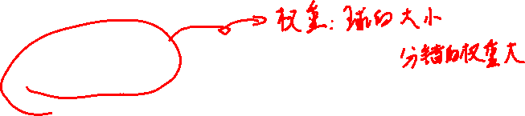
Formal Procedure of AdaBoost

Slide 11

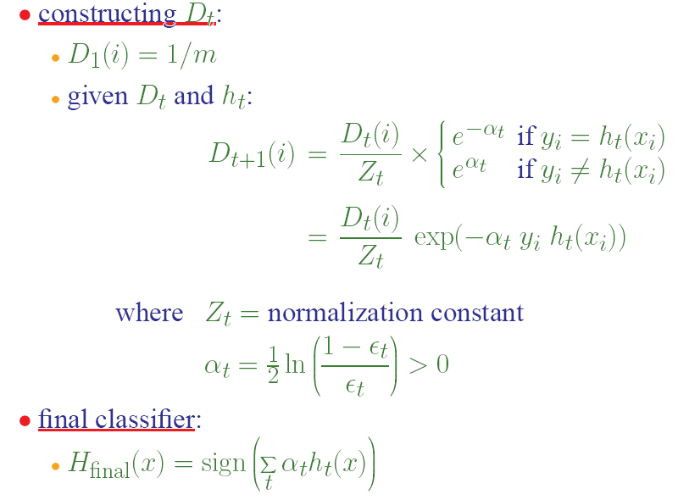
Procedure of Adaboost

Slide 12
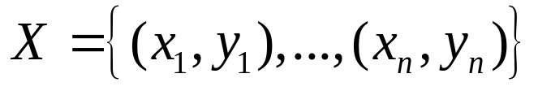





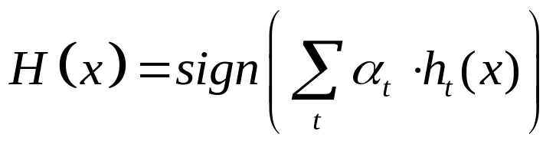
Adaboost – 算法
对于给定的训练样本集合
表示这些样本的真实标号
For (t = 1, …, T)
  在 构造
  找到弱分类器
  使得分类误差： 最小
输出最终的假设（分类器）

Slide 13


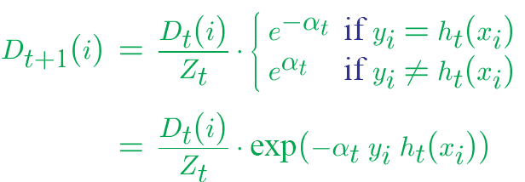


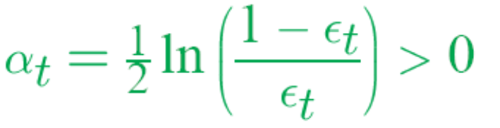
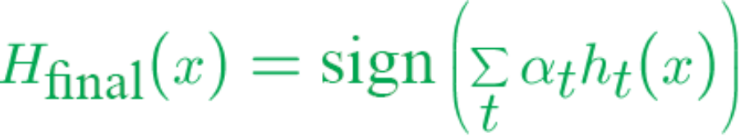
Adaboost – 算法
改变训练过程中样本集合的重要性（权值）
给定 与 令
  其中 是归一化常数
输出最终的假设（分类器）

Slide 14
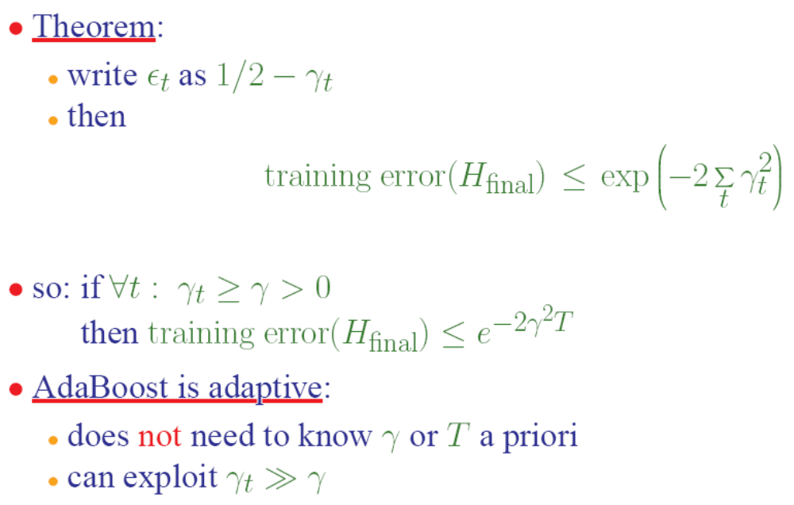
Error on Training Set
Proof later on black board if anyone interested and time permits

Slide 15
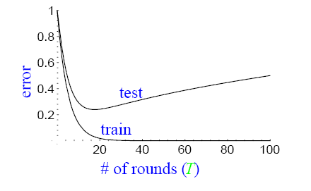
But we are NOT interested in Training set
Will Adaboost screw up with a fat complex classifier finally?
Occam’s razor – simple is the best
Over fitting
Shall we stop before over fitting? If only over fitting happens.

Slide 16
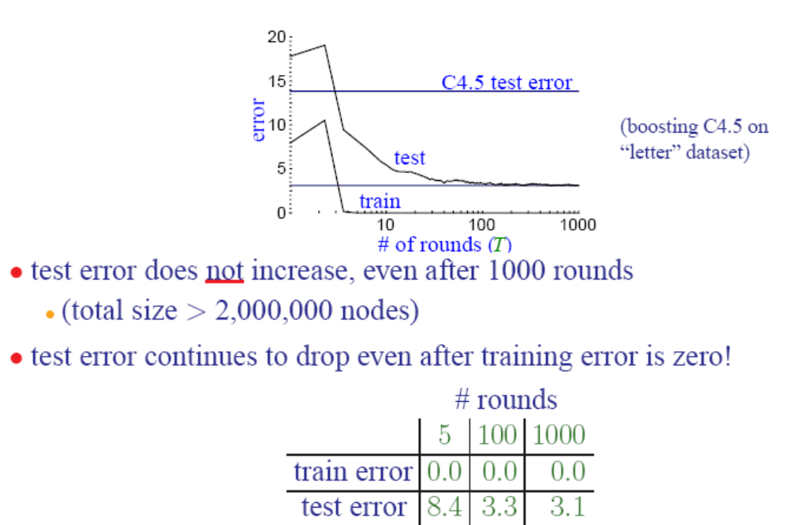
Actual Typical Run

Slide 17
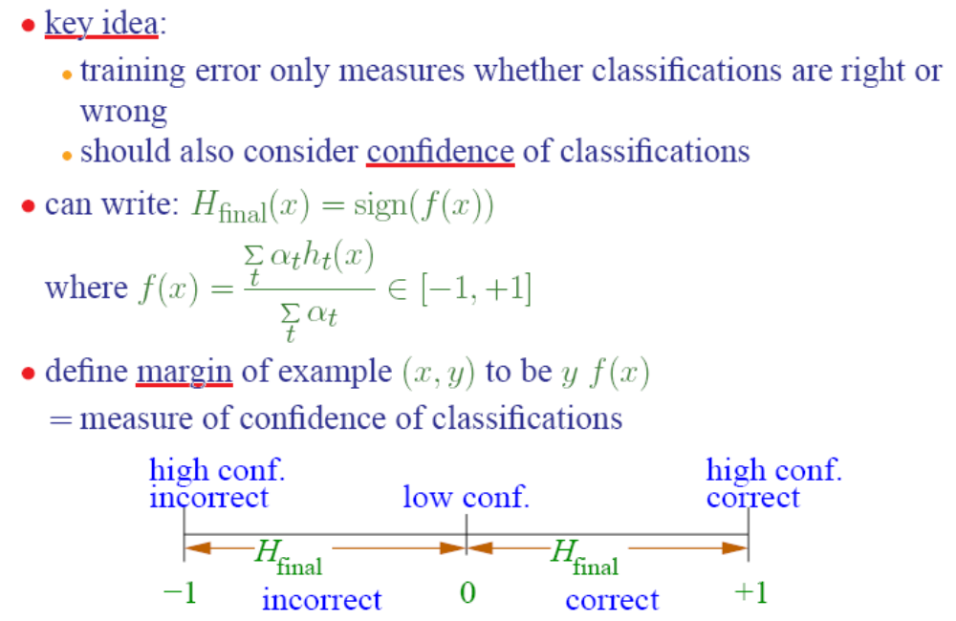
An explanation by margin
This margin is not the margin in SVM

Slide 18
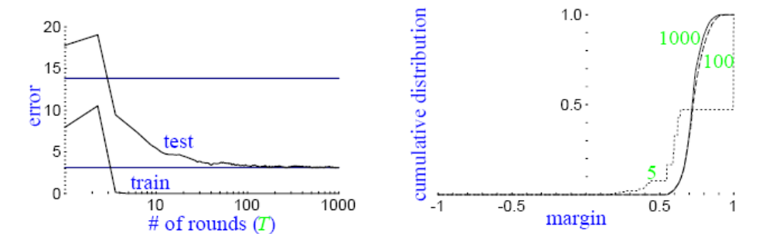
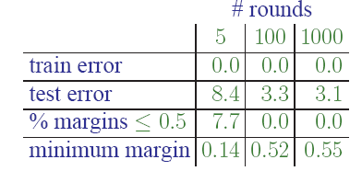
Margin Distribution
Although final classifier is getting larger, margins are still increasing
Final classifier is actually getting to simpler classifer

Slide 19
Two Questions
Will adaboost always maximize the margin?
AdaBoost may converge to a margin that is significantly below maximum. (R, Daubechies, Schapire 04)
If finally we reach a simpler classifier, is there anyway to compress it? Or can we bypass boosting but reach a simple classifier?

Slide 20
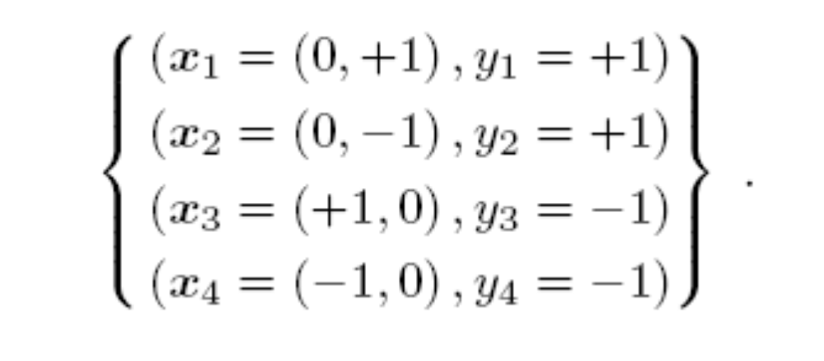
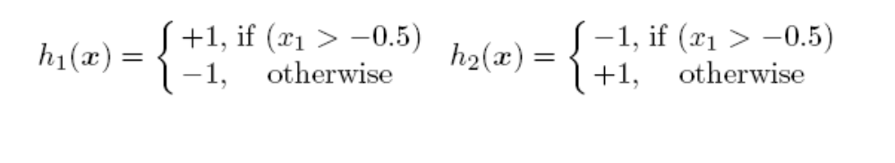
XOR problem

Slide 21
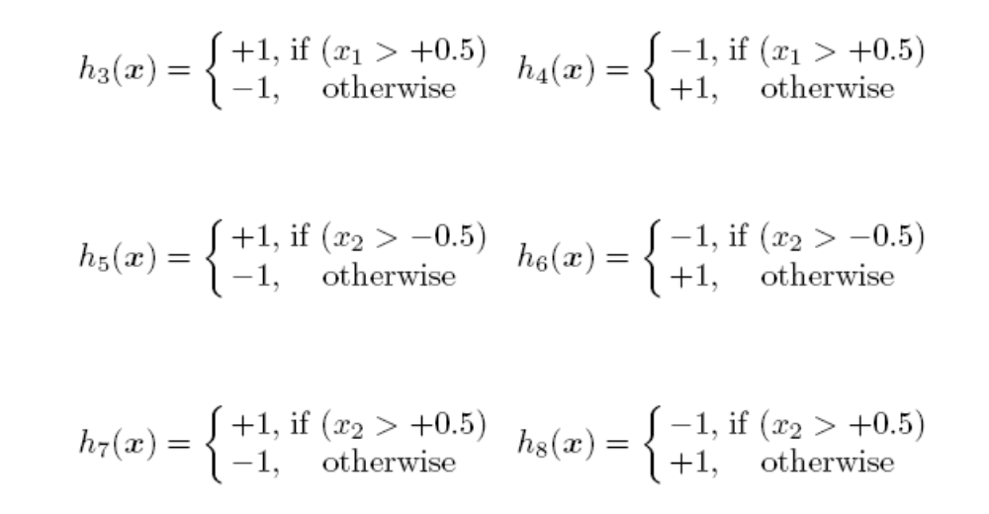
XOR problem

Slide 22
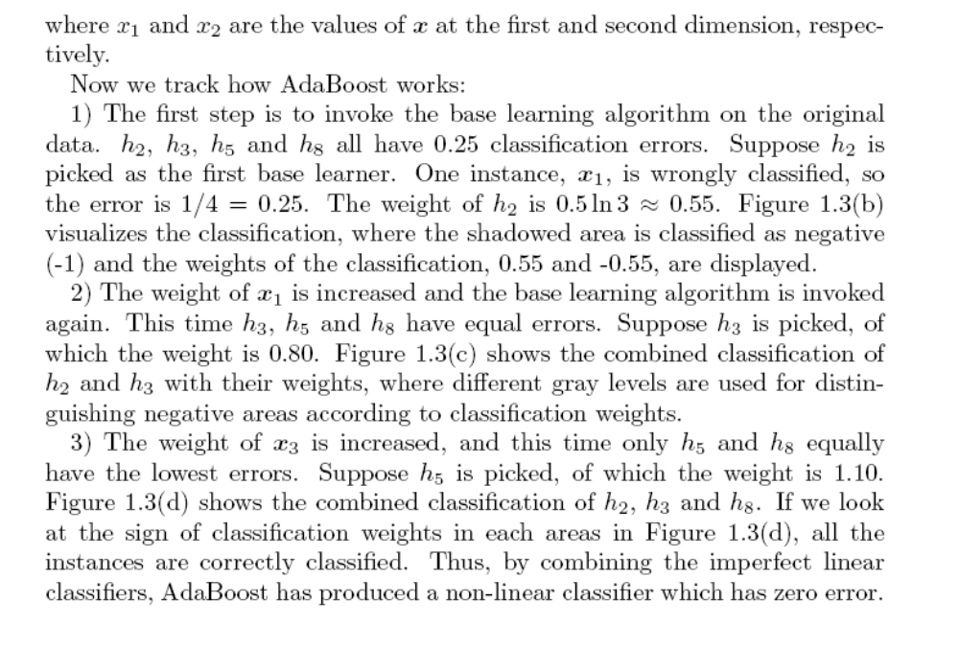
XOR problem

Slide 23
Robust Real-time Object Detection
Viola & Jones
Key Ideas
  Integral Image
  Critical feature selection and better detection using AdaBoost
  Classifier cascade to minimize computation

Slide 24
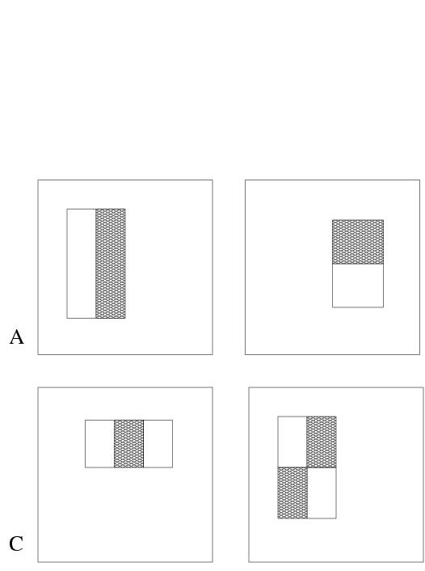
The features used
Rectangular feature types:
  two-rectangle feature (horizontal/vertical)
  three-rectangle feature
  four-rectangle feature
Using a 24x24 pixel base detection window, with all possible combinations of orientation, location and scale of these feature types the full set of features has 49,396 features.
The motivation behind using rectangular features, as opposed to more expressive steerable filters is their extreme computational efficiency.

Slide 25
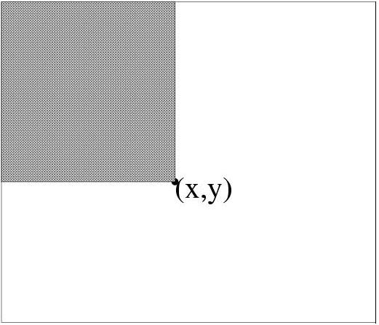
Integral image
Def: The integral image at location (x,y), is the sum of the pixel values above and to the left of (x,y), inclusive.
Using the following two recurrences, where i(x,y) is the pixel value of original image at the given location and s(x,y) is the cumulative row sum, we can calculate the integral image representation of the image in a single pass.
s(x,y) = s(x,y-1) + i(x,y) ....... integration along rows
ii(x,y) = ii(x-1,y) + s(x,y) ....... integration along columns

Slide 26
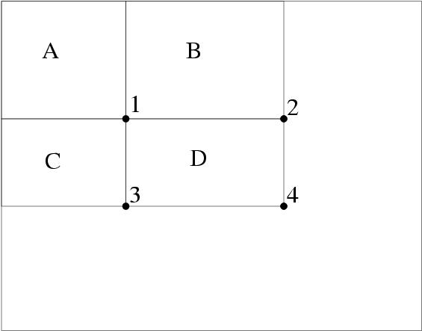
Rapid evaluation of rectangular features
Using the integral image representation one can compute the value of any rectangular sum in constant time.
For example the integral sum inside rectangle D we can compute as:
ii(4) + ii(1) – ii(2) – ii(3)
As a result two-, three-, and four-rectangular features can be computed with 6, 8 and 9 array references respectively.

Slide 27
Learning a classification function
Given a feature set and labeled training set of images one can apply several machine learning techniques.
However, there is 45,396 features in each image sub-window, hence the computation of all features is computationally prohibitive.
Classifier should combine a small subset of discriminative features so as to yield an effective classification.
Challenge: Find these discriminant features.

Slide 28
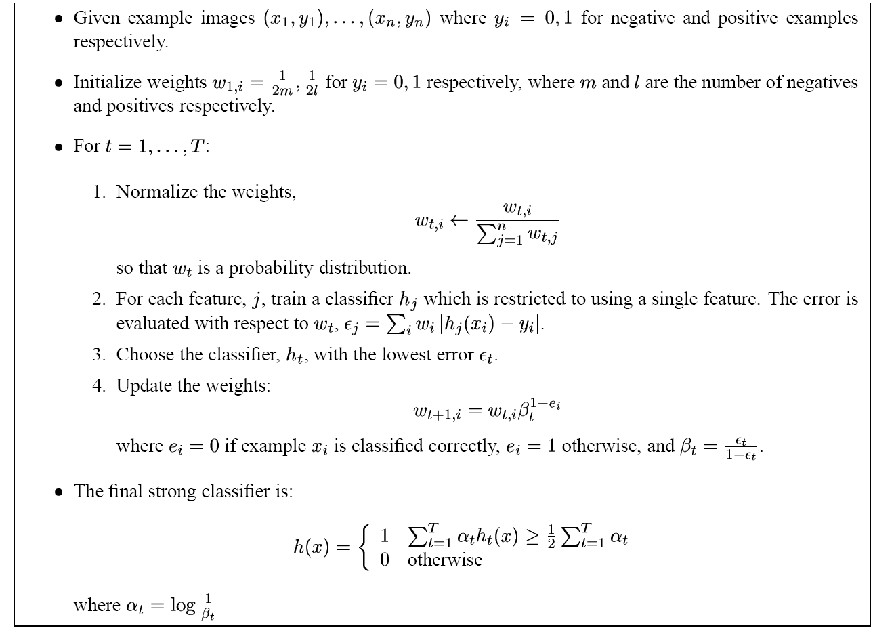
AdaBoost for aggressive feature selection

Slide 29
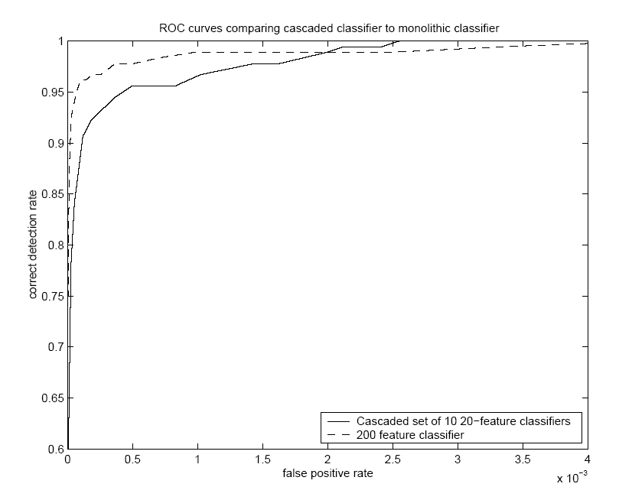
Performance of 200 feature face detector
The ROC curve of the constructed classifiers indicates that a reasonable detection rate of 0.95 can be achieved while maintaining an extremely low false positive rate of approximately 10⁻⁴.
First features selected by AdaBoost are meaningful and have high discriminative power
By varying the threshold of the final classifier one can construct a two-feature classifier which has a detection rate of 1 and a false positive rate of 0.4.

Slide 30
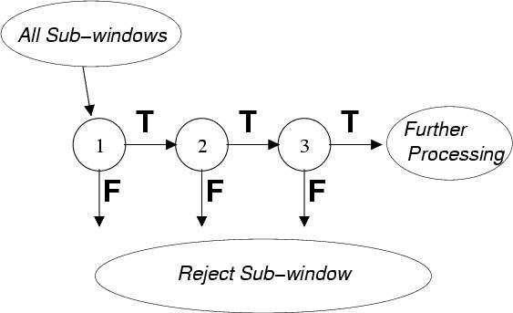
Speed-up through the Attentional Cascade
Simple, boosted classifiers can reject many of the negative sub-windows while detecting all positive instances.
Series of such simple classifiers can achieve good detection performance while eliminating the need for further processing of negative sub-windows.
Training: subsequent classifiers are trained only on examples which pass through all the previous classifiers.

Slide 31
Adaboost – 应用
Cascade 分类器
Y
Y
Y
…
N
N
N
Ad boost leaner
积分图特征（快速特征计算）
+

Slide 32
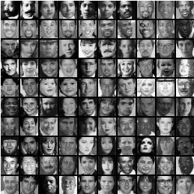
Experiments (dataset for training)
4916 positive training examples were hand picked aligned, normalized, and scaled to a base resolution of 24x24
10,000 negative examples were selected by randomly picking sub-windows from 9500 images which did not contain faces

Slide 33
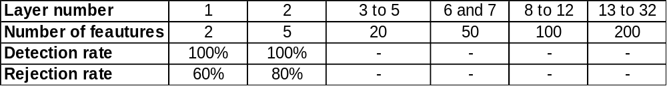
Experiments cont.
The final detector had 32 layers and 4297 features total
Speed of the detector ~ total number of features evaluated
On the MIT-CMU test set the average number of features evaluated per subwindow is 8 (out of 4297).
The processing time of a 384 by 288 pixel image on a conventional personal computer is about .067 seconds.

Slide 34
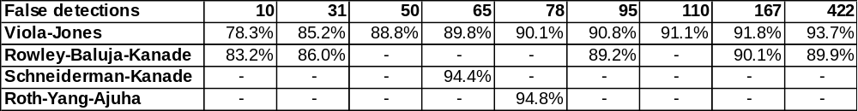
Results
Testing of the final face detector was performed using the MIT+CMU frontal face test set which consists of:
130 images
507 labeled frontal faces
Results in the table compare the performance of the detector to best face detectors known.
Rowley at al.: use a combination of two neural networks (simple network for prescreening larger regions, complex network for detection of faces).

Slide 35


Slide 36
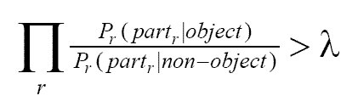
Object Detection Using the Statistics of Parts
  Henry Schneiderman & Takeo Kanade
  AdaBoost based
  Parts based representation : Localized groups of discretized wavelet coefficients as features
  Likelihood obtained using probability tables and statistical independence of parts
  Uses likelihood ratio test classifier

Slide 37
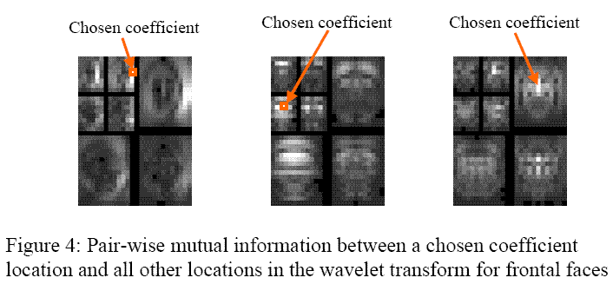

Slide 38
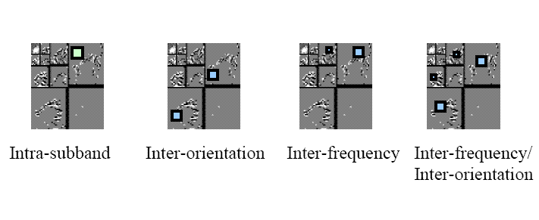
Parts are localized in position and frequency

Slide 39
  Algorithm uses exhaustive search across position, size, orientation, alignment and intensity.
  Course to Fine Evaluation
  Wavelet Transform coefficients can be reused for multiple scales
  Color preprocessing
  Time – 5 s for 240x256 image (PII 450 MHz)

Slide 40
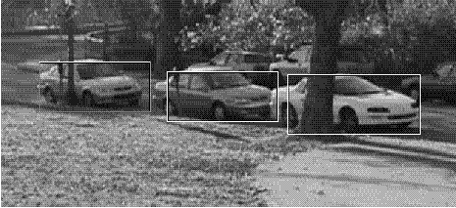
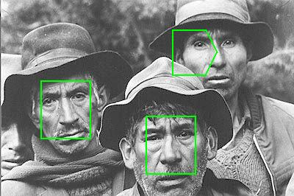
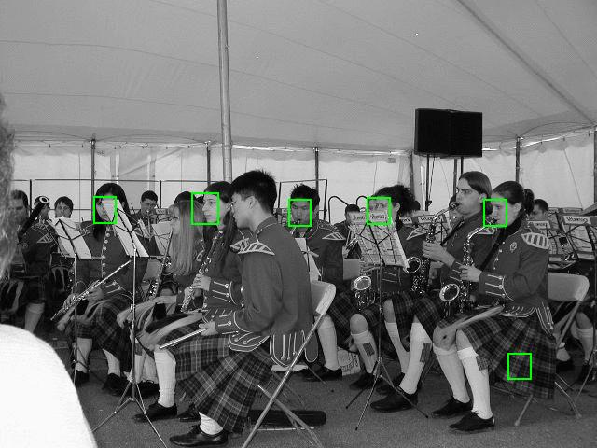

Slide 41
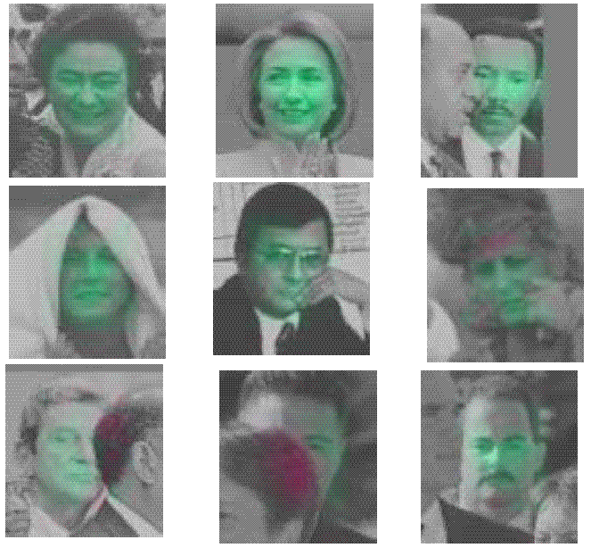
What are the important parts?

Slide 42
Conclusions
  The Viola&Jones paper uses very simple features which are very fast to compute.
  Integral image representation is used to speed up the feature calculation.
  AdaBoost used for improving the classification and efficient feature selection.
  A cascade of classifiers is used to minimize the computation without sacrificing the classification performance.
  The final face detector is comparable in performance to other existing classifiers, but orders of magnitude faster.
  The Schneiderman & Kanade paper uses part based features using wavelet coefficients.
  Classifier is based on likelihood ratio test. The likelihoods are obtained from probability tables constructed while training.
  AdaBoost is used to improve the performance..

Slide 43
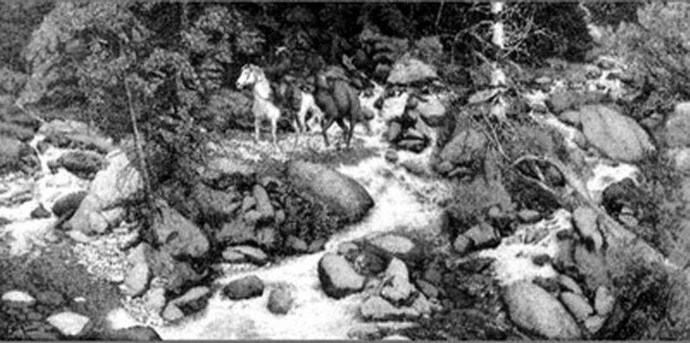
How many faces in this picture ?

Slide 44
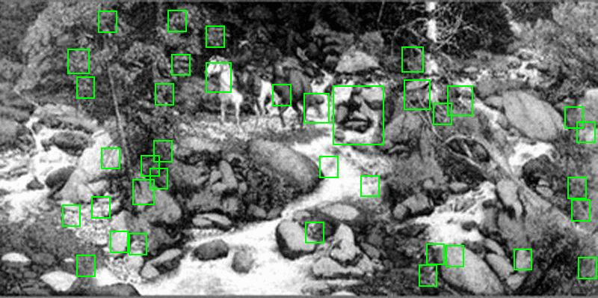

Slide 45
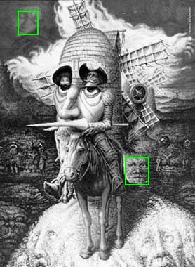
What about this ?

Slide 46
A demo of Viola and Jones
http://mplab.ucsd.edu/
思考题：
与SVM的区别？
针对多类问题如何扩展？

